Slide 1

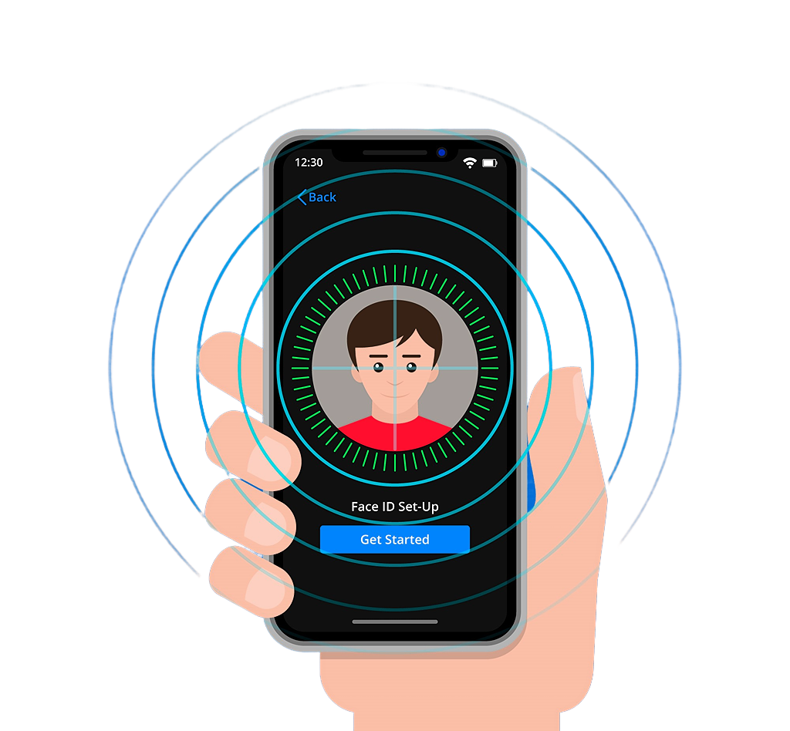
YOUR FACE, YOUR PRESENCE, YOUR TIME
Snap Attendance System
Presented By :
Kishor Nikhare
Krushita Bheda
Prashant Chaute

Slide 2

Agenda Outline
Introduction
Take Attendance
Project Objectives
Capture Images
Phases Of Project
System Testing
Technologies Used
Limitations And Future Scope
Data Flow Diagram
Conclusion
Login Functionality
References

Slide 3

Introduction Of Snap Attendance

Slide 4
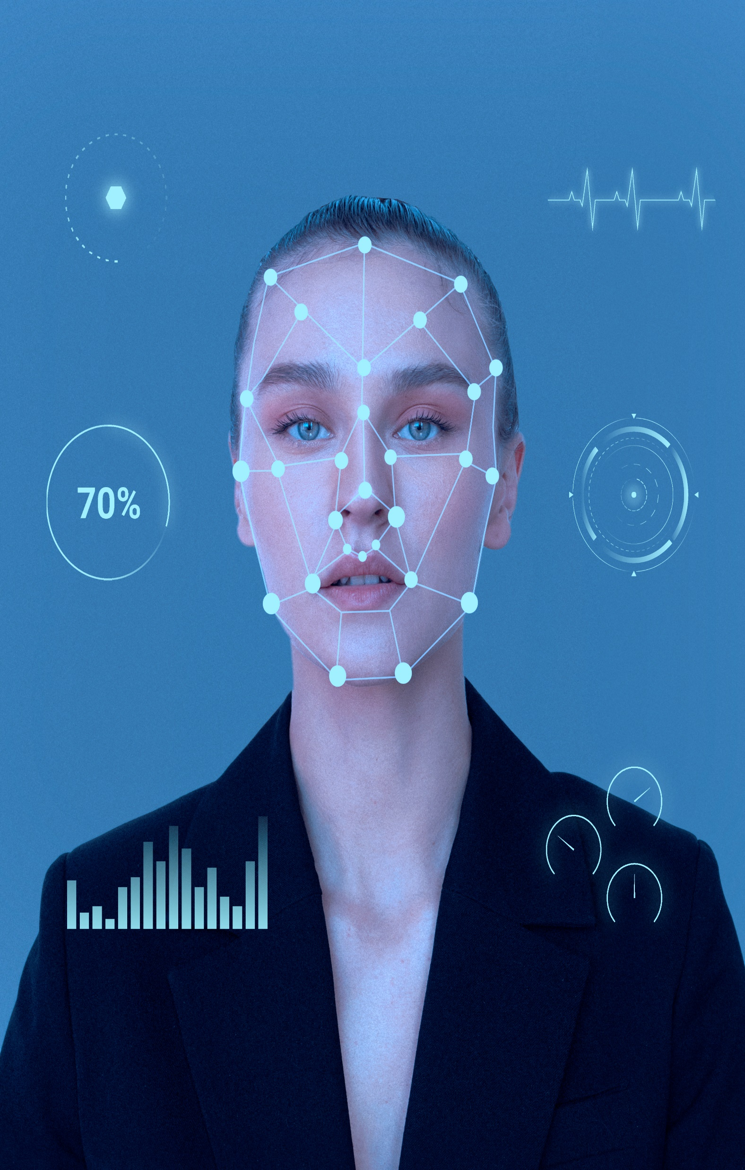
Initial Overview
Welcome to Snap Attendance! We have developed an automated attendance system that uses face recognition technology.
It is as simple as taking a photo to mark your attendance. Our system efficiently recognizes faces, saving time and effort.
Our goal is to eliminate manual attendance taking attendance and reduce paper works.
We offer user-friendly interface, allowing both students and teachers to login easily.

Slide 5
Objectives Of
Snap Attendance

Slide 6


Project Objectives
Our project aims to develop an automated attendance system using face recognition technology.
We focus on creating a user-friendly interface, ensuring easy navigation and accessibility.
Teachers will have administrative control over student details.
Our objective is to achieve efficient and close to accurate face recognition for attendance marking, minimizing error and improving reliability.

Slide 7
Phases Of
Snap Attendance

Slide 8
Stages of Snap Attendance
Learn about the different stages in creating Snap Attendance, Our user-friendly automated system.
Planning
Research
Design
Deciding what needs to be done and how. This involves setting goals and creating a roadmap for the project.
Learning about face recognition and what users need. This phase also involves talking to users to understand their needs and preferences and gathering all the necessary information.
Making plans and drawings for how the system will work. This includes creating blueprints and prototype to visualize the final product.

Slide 9
Stages of Snap Attendance
Learn about the different stages in creating Snap Attendance, Our user-friendly automated system.
Development
Testing
Deployment
Building the system according to the plans. Here, programmers write the code and put pieces of the system together.
Trying out the system to make sure it works perfectly. This phase involves running different tests to find and fix any problem or bugs.
Putting the system into use of everyone. This phase includes installing the system and making sure it works for all users.

Slide 10

Technologies Used In Snap Attendance
Discover the different moderns tools and methods we have used to create Snap Attendance, making attendance tracking easier and more efficient than ever.

Slide 11
Frontend Technology
Backend Technology
Face Recognition Model
We used HTML to create the basic structure of the web pages.
Python served as the primary programming language for the backend development.
The Face Recognition model played a crucial role in identifying students faces in real-time.
CSS to style the web pages and make visually appealing.
The Flask library facilitated the creation of web applications in Python.
It was trained to recognize faces accurately from various angles and lighting conditions.
JavaScript handled client-side validation, ensuring user inputs are correct.
SQLite database was employed to store and manage student details efficiently.
The model’s accurate result ensured reliable attendance tracking and enhanced user experience.
AJAX for handling the request to the
server without reloading the entire page.
The other libraries like OpenCV, OS, NumPy etc.. to make automated attendance system.
Additionally we have used already published templates for designing.

Slide 12
Data Flow Diagram Of Snap Attendance
Visualize the flow of data within Snap Attendance, simplifying the understand of how information moves through the system.

Slide 13
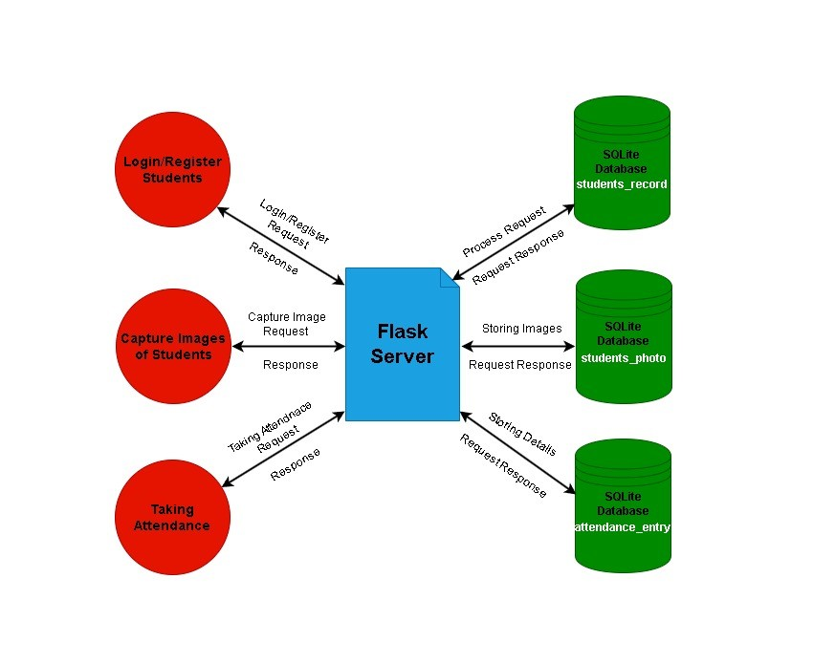
Data Flow Diagram
A Data Flow Diagram (DFD) shows how information moves through a system.
In Snap Attendance, it illustrates how data moves from where it's inputted, like when users interact with the system, to different parts of the system for processing and storage.
This diagram helps us understand how Snap Attendance works, like what happens to the data after it's inputted, and helps us make sure everything runs smoothly.

Slide 14
Login Functionality Of Snap Attendance
Explore the user-friendly login process of Snap Attendance, ensuring easy access for all the users. Discover how students and teachers securely log in to access attendance records and manage accounts efficiently.

Slide 15
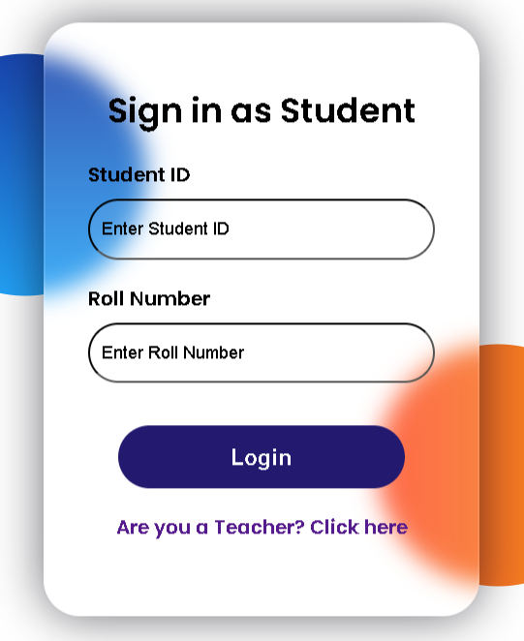
For Student
Students can easily access Snap Attendance using their provided student id and roll number. Once logged in, they can see their own dashboard :
1. View Attendance Entry
2. Access Profile Details
3. See Recent Attendance
4. Logout

Slide 16
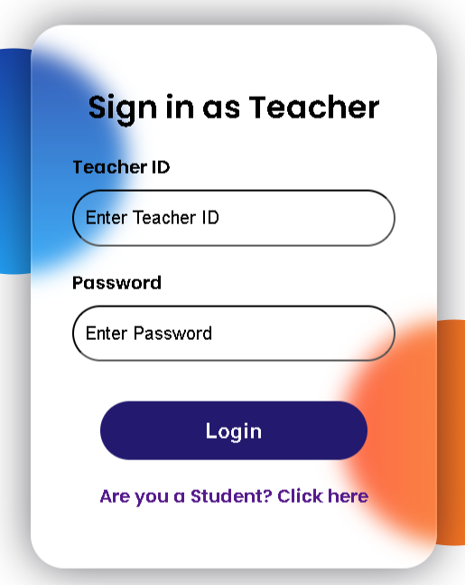
For Teacher
Teacher have access to Snap Attendance’s comprehensive features to manage attendance. Teachers can do :
1. Take Attendance
2. Capture Student Images
3. Add Student
4. Update Records
5. Export Records

Slide 17
The Main Process Take Attendance

Slide 18
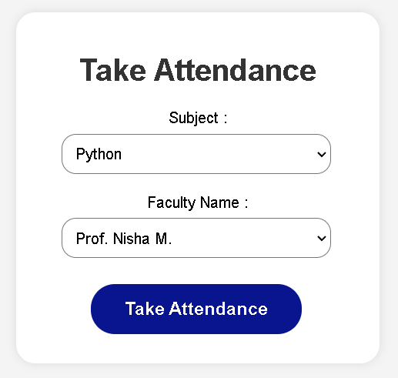
Take Attendance
In the Snap Attendance, Taking Attendance is the important component. Only authorized teachers can take attendance. Here how it works :
1. Select Subject and Teacher Name
2. Clicks On Take Attendance Button
3. Webcam Activation
4. Face Recognition
5. Database Storage

Slide 19
The Sub Process Capture Images

Slide 20
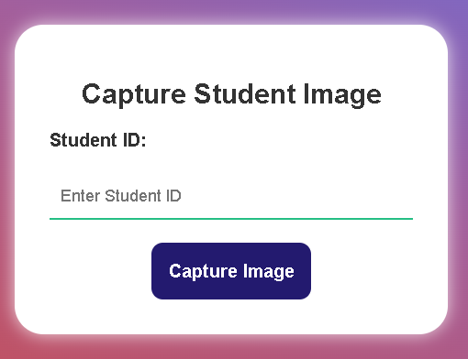
Capture Images
In Snap Attendance, capturing student images is an important step to ensure accurate face recognition during attendance. Here how it works:
1. Assign Existing Student ID
2. Webcam Activation
3. Capture Images
4. Quality Assurance
5. Benefit in Attendance

Slide 21
System Testing Of
Snap Attendance

Slide 22

System Testing
System Testing is a critical phase in the development of Snap Attendance, ensuring that all components work together and meet the project requirements. During this phase :
Functionality Testing
Performance Testing
3. Usability Testing
Result Tracking Testing
5. Manually Testing

Slide 23
Limitations and Future Scope Of Snap Attendance
Understand the boundaries of Snap Attendance’s capabilities and potential for further development.

Slide 24

Limitations
Understand the current constraints of Snap Attendance, including potential issues with face recognition accuracy or hardware compatibility.
Hardware Dependance
Performance Issues
3. Security Concerns
Mobile Compatibility

Slide 25

Future Scope
There are opportunities for future enhancements to further improve the functionality, usability, and performance of the application.
Mobile Application Development
Biometric Authentication
3. UI Enhancements
Performance Optimization
5. Manually Testing

Slide 26
Conclusion
Understand the Conclusion of Snap Attendance

Slide 27

The
Conclusion
Of
Snap
Attendance
In summary, Snap Attendance makes attendance tracking easy for schools.
Using smart face recognition, it accurately records who's present.
With its user-friendly design and thorough testing, Snap Attendance ensures it works well.
Looking ahead, it could do even more with real-time data and better accuracy.
Snap Attendance is set to change how schools take attendance, making it simpler and more reliable for everyone.

Slide 28

1. Face Recognition Library
2. OpenCV Documentation
References
3. Perplexity AI
4. YouTube

Slide 29
Thank You

